Slide 1

Bengaluru– 560 038, Karnataka, INDIA
Presentation on
FAKE NEWS DETECTION
Submitted by:
ADITI GUPTA
Internal Guide
KHUSBOO GARG
SME
Flip Robo Technologies
PGP Instructor
Dr. Deepika Sharma
Training Head
DataTrained

Slide 2
Contents
Introduction
Problem statement
Data escription
Objectives of the study
Hardware and Software Used
Data Preprocessing
EDA
Building Word Dictionary
Model Training
Key Metrics
Best Model
Prediction
Conclusions
Learning Outcomes in Data Science
Limitations & Scope for future work

Slide 3
Introduction
The idea of fake news is often referred to as clickbait in social trends and is defined as a “made up story with an intention to deceive, geared towards getting clicks”. Some news articles have titles which grab a reader’s interest. Yet, the author only emphasizes a specific part of the article in the title. If the article itself does not focus on or give much truth to what the title had written, the new may be misleading.

Slide 4
Problem Statement
The authenticity of Information has become a longstanding issue affecting businesses and society, both for printed and digital media. On social networks, the reach and effects of information spread occur at such a fast pace and so amplified that distorted, inaccurate, or false information acquires a tremendous potential to cause real-world impacts, within minutes, for millions of users. Recently, several public concerns about this problem and some approaches to mitigate the problem were expressed. In this project, you are given a dataset in the fake-news_data.zip folder.

Slide 5
Data Description
There are 6 columns in the dataset provided to you. The description of each of the column is given below:
“id”: Unique id of each news article
“headline”: It is the title of the news.
“news”: It contains the full text of the news article
“Unnamed:0”: It is a serial number
“written_by”: It represents the author of the news article
“label”: It tells whether the news is fake (1) or not fake (0).

Slide 6
Objective
The objective of identification of News are :
To give knowledge to the user about the fake news and real news
To classify that news are fake or not.

Slide 7
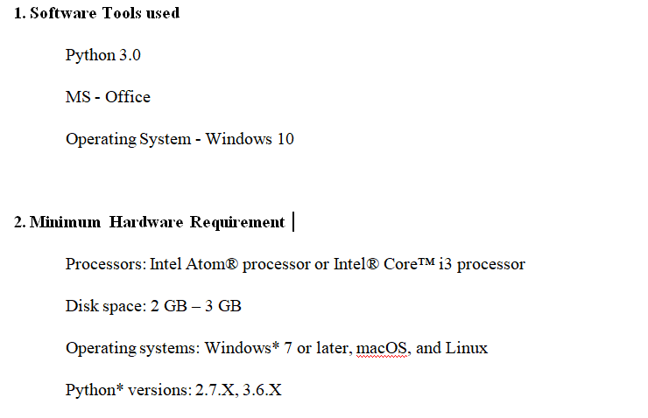
Hardware and Software Requirements and Tools Used

Slide 8
DATA PREPROCESSING

Slide 9
DATA PREPROCESSING STEPS
Convert all letters to lower/upper case
Removing numbers
Removing punctuation
Removing white spaces
Removing hyperlink
Removing stop words
Removing Short words (length<=3)
Word lemmatization
Adding 4 new columns (Content,content_length,clean_content,clean_content_length)
Vectorisation (Using Tf/idf)

Slide 10
EXPLODATORY DATA ANALYSIS

Slide 11
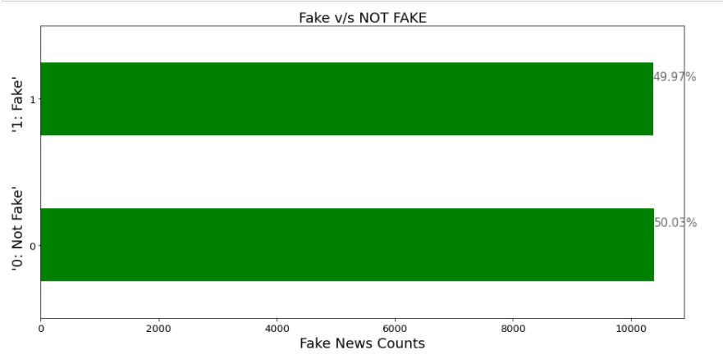
Count of Fake and not Fake News

Slide 12
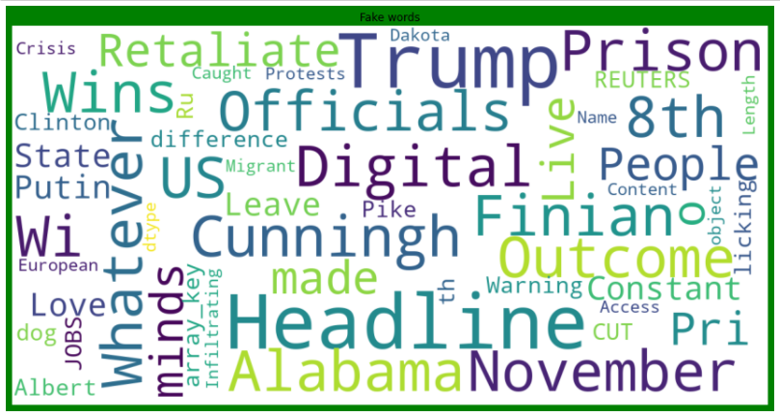
Frequent Fake words before cleaning

Slide 13
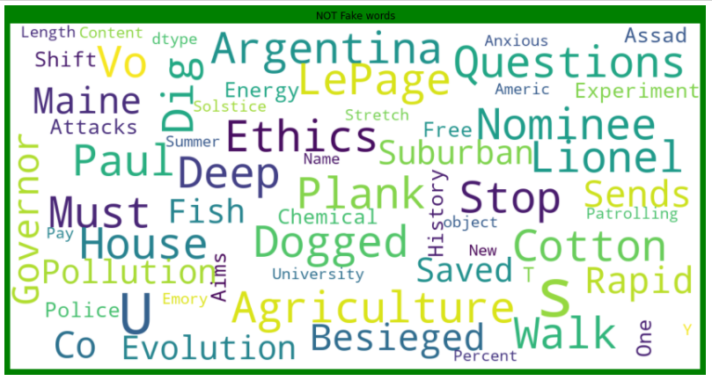
Frequent Not Fake words before cleaning

Slide 14
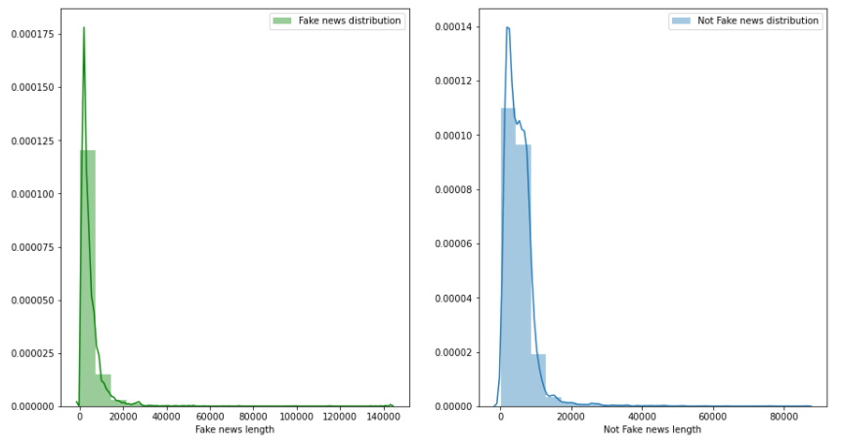
Length Distribution of Fake and Not fake words before cleaning

Slide 15
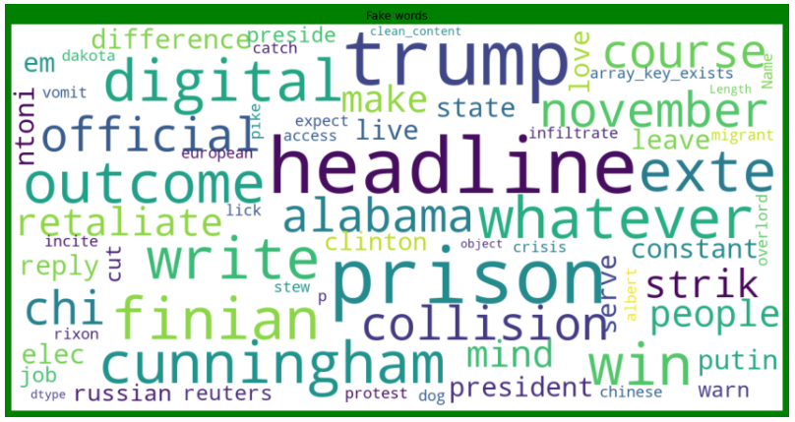
Frequent Fake words after cleaning

Slide 16
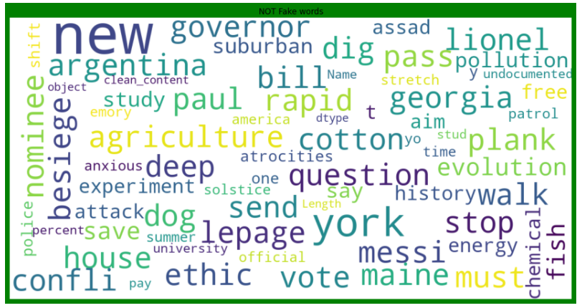
Frequent Not Fake words after cleaning

Slide 17
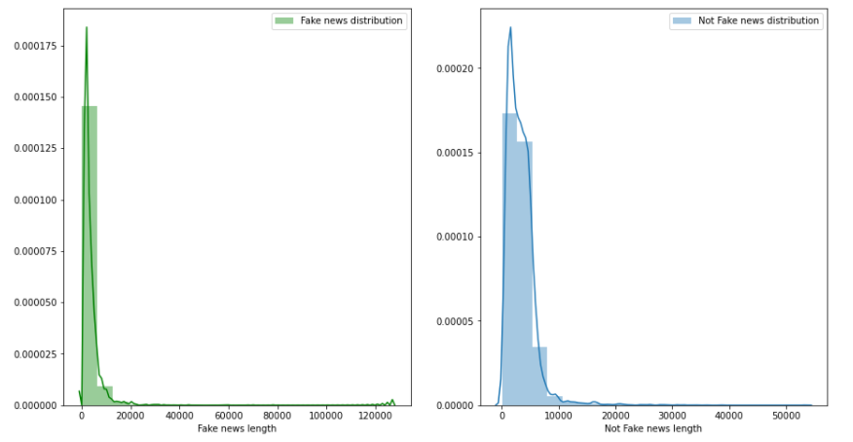
Length Distribution of Fake and Not fake words after cleaning

Slide 18
BUILDING WORD DICTIONARY

Slide 19
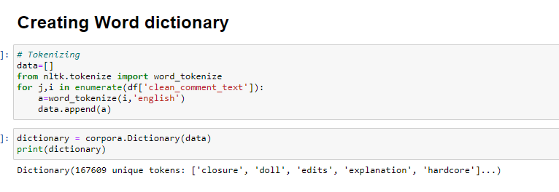
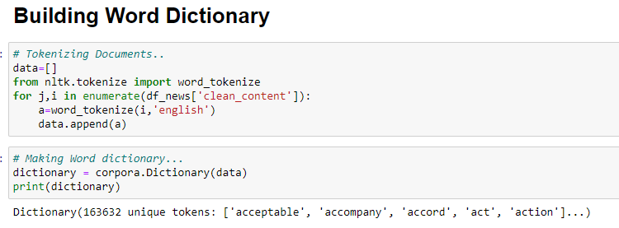

Slide 20
MODEL TRAINING

Slide 21
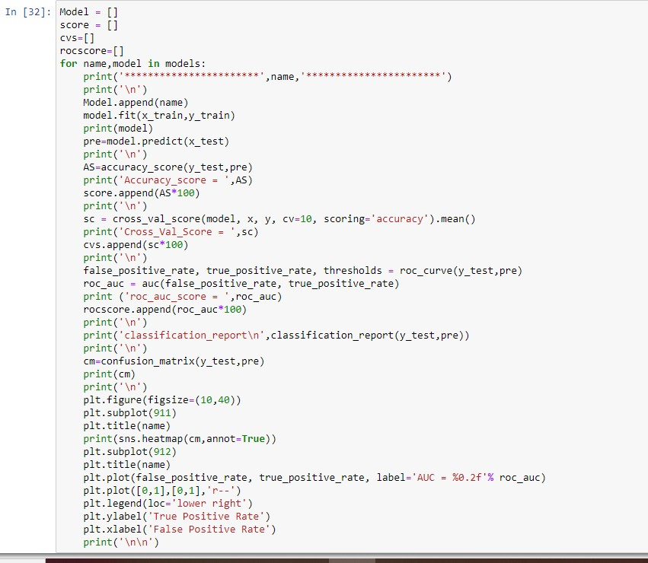
Model/s Development and Evaluation
From the given dataset it can be concluded that it is a Classification problem as the output column “label” has binary output “0 & 1”. So for further analysis of the problem we have to import or call out the Classification related libraries in Python work frame.

Slide 22
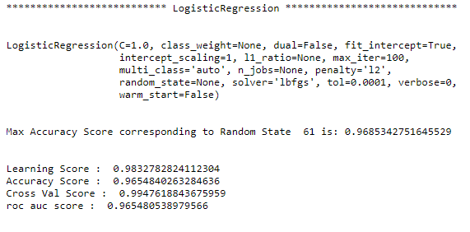
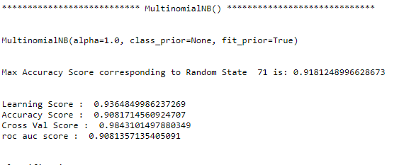
Logistic Regression
MultinimialNB

Slide 23
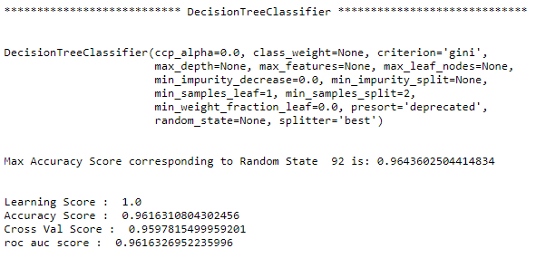
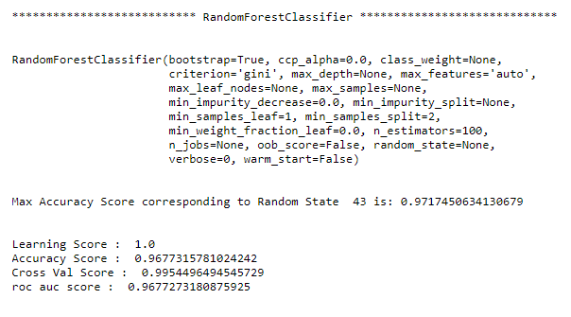
Decision Tree Classifier
Random Forest Classifier

Slide 24
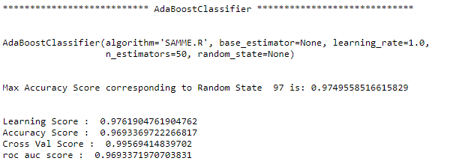
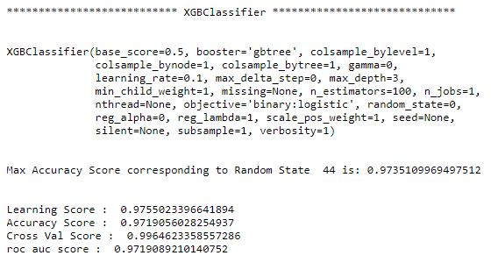
AdaBoost Classifier
XGB Classifier

Slide 25
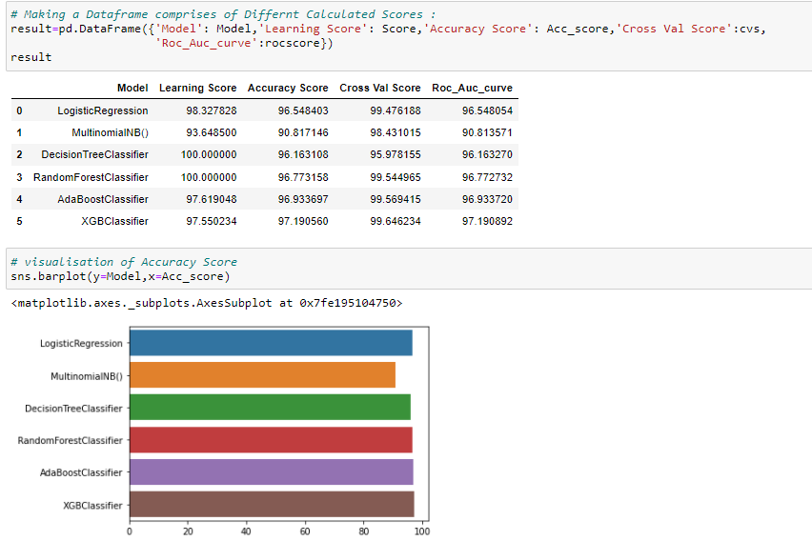
Key Metrics for success

Slide 26
BEST MODEL

Slide 27
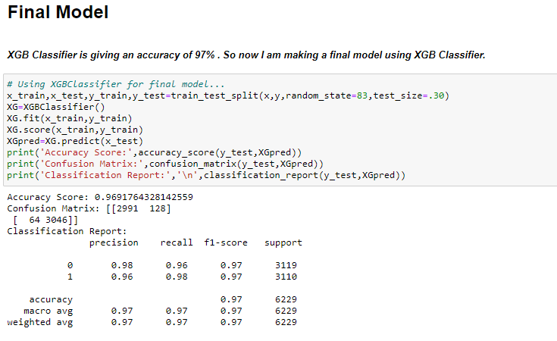
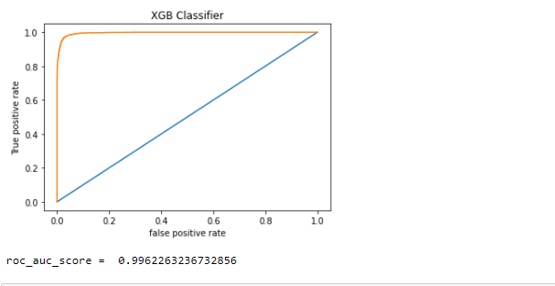
Choosing Best Model
The XGB Classifier model is working best and can be considered as finalised model.

Slide 28
PREDICTION

Slide 29
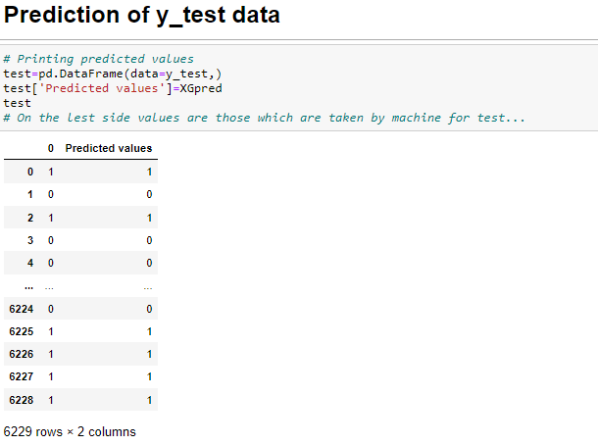
Predict the test data using Random Forest Classifier

Slide 30
CONCLUSION

Slide 31
Key Findings and Conclusions of the Study
From the whole evaluation we can see that the maximum number of words in fake news were regarding Trump, and Clinton and we can interpret that it was due to election campaign which was held during US presential election and we know these adverse effects of the voters which were influenced by the fake news and most of the real news had said, trump and president, and fake news which was cleared by trump’s campaign, but can hardly see any clarity or real news from the side of Clinton, and due to which the impact we already saw on election results and regarding the election advertisement and news Facebook’s CEO Mark Zuckerberg also got extensively question by congress. So, from the words frequency chart we can clearly see that most of the news were related to US presedential election between Trump and Clinton, and by implementing passive aggressive algorithms we can see that the we have achieved a good score as it calculates the errors and updates its own learning rate which makes our model more reliable.

Slide 32
Learning Outcomes of the Study in respect of Data Science
Through this project we were able to learn various Natural language processing techniques like lemmatization, stemming, removal of stopwords. We were also able to learn to convert strings into vectors through hash vectorizer. In this project we applied different evaluation metrics like log loss, hamming loss besides accuracy.
Limitations of this work and scope for future
Some of the limitations can be:
Machine learning algorithms like GradientBoosting Classifier takes enomorous time more than a day to build tha model.
Using Hyperparameter Tuning forXGB Classifier wouls increase our score.
Using Deep Learning Techniques may increase our score.

Slide 33
THANK YOU

